Slide 1
Your AI use policy
What may my staff do with AI, and what rules should my company set?
Applied AI and Automation | Session 9 of 12
KLAi Professional Learning | Jotham Martin Wambi
Notes:
Welcome to Session 9. Until now you have watched what AI can do and where it fails. Today you write the rules. By the end of the session you hold a first draft of your own company AI use policy and a risk register for your task. We start from an invented handbook clause from Nile Valley Foods, and you work on your own company for forty-five minutes.
Before we begin, tell me in one sentence which AI use in your company worries you most, and if you brought a rule your company already has, keep it handy.

Slide 2



Today in one view: what you will leave with
By the end of today you will have
A risk register for your own task: each risk scored, with an owner and a control
A first draft of your company AI use policy: approved tools, data rules, human review, records, incidents and an owner
A plain view of the rules that apply to you in Uganda, and the names of the frameworks you will hear
Notes:
Here is what you leave with today. A risk register for your own task, with each risk scored and given an owner and a control. A first draft of your company AI use policy, built from the template. And a plain view of what the law says in Uganda and the names of the frameworks you will hear in meetings.
The legal part is short, and I say clearly where your lawyer takes over.

Slide 3
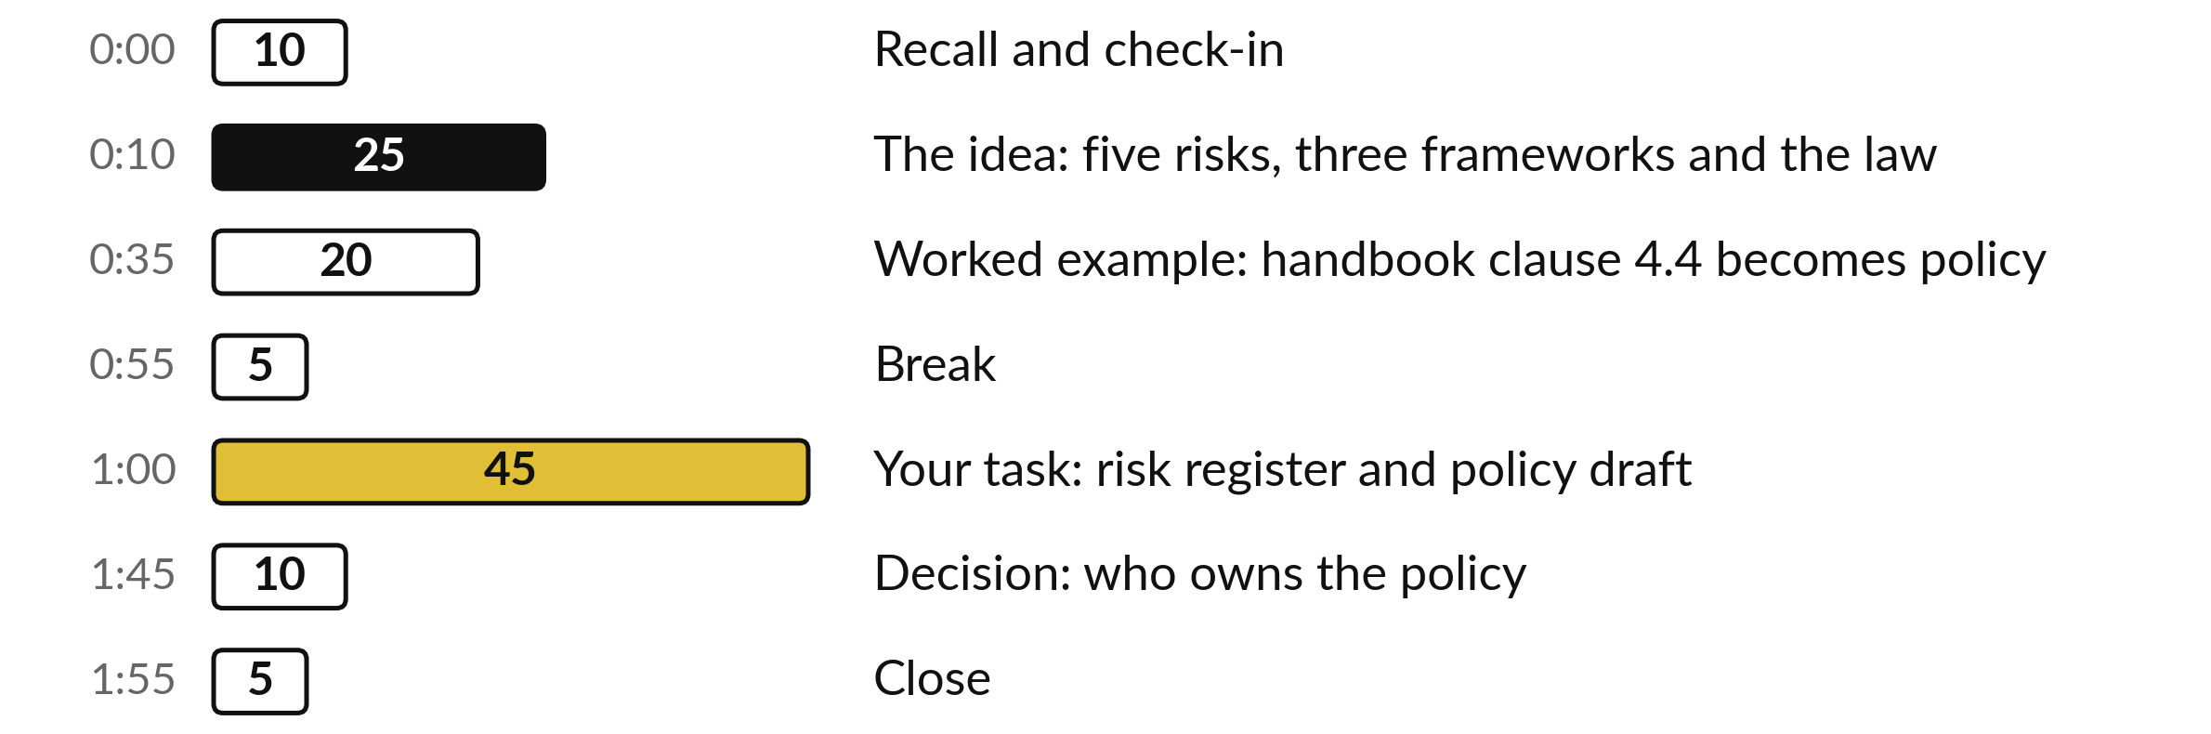
Your two hours: 45 minutes are your own work
45 of the 120 minutes are yours: a risk register and a policy draft for your own company.
Notes:
Three parts take most of the time. Twenty-five minutes on the idea: five risks, three frameworks and the law in Uganda. Twenty minutes on a worked example, where one handbook clause from Nile Valley Foods becomes part of a policy. After the break, forty-five minutes are yours: the risk register first, then the policy draft.
The last ten minutes are for one decision, who owns the policy.

Slide 4

Three questions from last time
1. In the AI workflow, who approves a reply before it goes out, and what does the AI do?
2. What did you compare side by side in Session 8?
3. What can the person do at the approval step, and what happens next?
Answer aloud first. Then we check together.
Notes:
Three quick questions from Session 8. Answer aloud first, and then we check together. It is a warm-up to bring last time back.
Question one. In the AI workflow, who approves a reply before it goes out, and what does the AI do? Take a moment.
A good answer is this. A person reads every draft and approves, edits or rejects it. The AI sorts the message and drafts the reply.
Question two. What did you compare side by side in Session 8? Say it to yourself first.
A good answer is this. The rule, the AI and a person, on the same twelve messages, set against the Session 1 baseline.
Question three. What can the person do at the approval step, and what happens next? Think about your own task as you answer.
A good answer is this. Send, edit or reject the draft. The result is logged, one row per message.
If an answer was missing, your own task card or last workbook page has it. Now to today.

Slide 5




Words we use today
Word | What it means
AI use policy | A short written rule for what staff may and may not do with AI tools at work.
Data class | A level of sensitivity for information: public, internal or confidential, with a flag for personal data.
Control | A real action that lowers a risk, such as a named person who checks the figures.
Prompt injection | Hidden text in an email or document that tricks an AI tool into following it.
Over-reliance | Trusting results because they are usually right, and checking less and less.
Notes:
Five words for today. I give the plain meaning of each, and we use every one of them before the end of the session.
AI use policy. A short written rule for what staff may and may not do with AI tools at work.
Data class. A level of sensitivity for information: public, internal or confidential, with a flag for personal data.
Control. A real action that lowers a risk, such as a named person who checks the figures.
Prompt injection. Hidden text in an email or document that tricks an AI tool into following it.
Over-reliance. Trusting results because they are usually right, and checking less and less.

Slide 6





Five risks cover most of what
goes wrong with AI at work
Risk | Where you saw it | A control that works
Made-up facts | Session 2 | A named person checks figures and quotes against the source.
Leakage of confidential data | Session 4 | Approved tools only, and a table of what data may go in.
Prompt injection | Session 7 | The tool drafts, and a person approves every send.
Bias | Session 5 | A person decides about people. Check results by group.
Over-reliance | Session 8: drafts that read well but were wrong | Keep a named checker and sample the results every month.
Notes:
Five risks cover most of what goes wrong. Made-up facts, which you saw in Session 2. Leakage of confidential data, which is why we sorted your information in Session 4. Prompt injection, hidden text in an email that tricks a tool, from Session 7. Bias, which the CV shortlist showed in Session 5.
And over-reliance, where people check less because the tool is usually right: the Session 8 drafts read well and still needed edits. Each risk has a control in the third column, an action that a person actually does. Which of the five worries you most in your own company? Tell me, and keep that one in mind for the register.

Slide 7
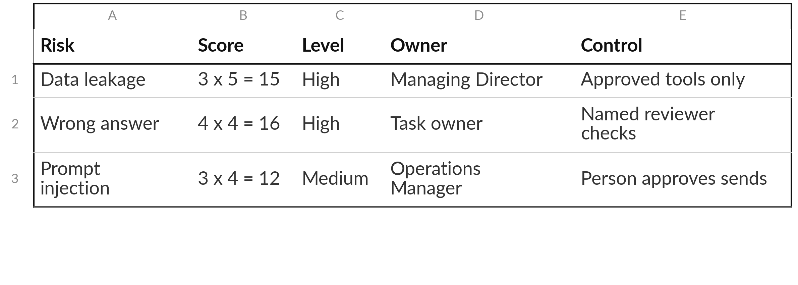
Score each risk, name an
owner and write one control
Example rows from the Risk Register template. High: 15 or more. Medium: 8 to 14. Low: below 8.
Notes:
Here are three finished rows from the Risk Register template. Likelihood from one to five, times impact from one to five, gives a score. Fifteen or more is High and needs a control and a report to the Managing Director. Eight to fourteen is Medium and needs a control and a review date.
Below eight is Low. Every row has one named owner and one real control. A row without both is only a worry. The template already holds eight typical rows, so you edit and delete and never start from a blank page. In a moment you edit the four rows that matter most for your task and add one for over-reliance.

Slide 8




Four names you will hear, and what each is for
Name | What it is | How you use it
OWASP Top 10 for LLM applications | A security list for AI applications. The 2025 list ranks prompt injection first. | Check what a vendor says about security.
NIST AI RMF 1.0 | A voluntary US framework: Govern, Map, Measure, Manage. | Use it as a checklist for your own policy.
ISO/IEC 42001 | A standard for managing AI that an auditor can certify. | Ask a vendor if it holds it, and what it covers.
EU AI Act | A law with reach beyond the EU. My understanding: it can apply to firms outside the EU whose AI output is used there. | Ask your lawyer if you sell there.
Notes:
Four names you will hear in meetings and in vendor pitches. OWASP publishes a list of the top security risks for AI applications, and its 2025 list ranks prompt injection first. NIST is a voluntary American framework with four functions, Govern, Map, Measure and Manage. You can use it as a checklist.
ISO forty-two thousand and one is a standard for managing AI that an auditor can certify. Ask what a certificate covers before you rely on it. The EU AI Act is a law, and its reach goes beyond the EU. My understanding is that it can apply to a company outside the EU whose AI is placed on the EU market or whose output is used there, and that its dates have been revised.
So ask your lawyer if you sell there. Confirm with your lawyer.

Slide 9
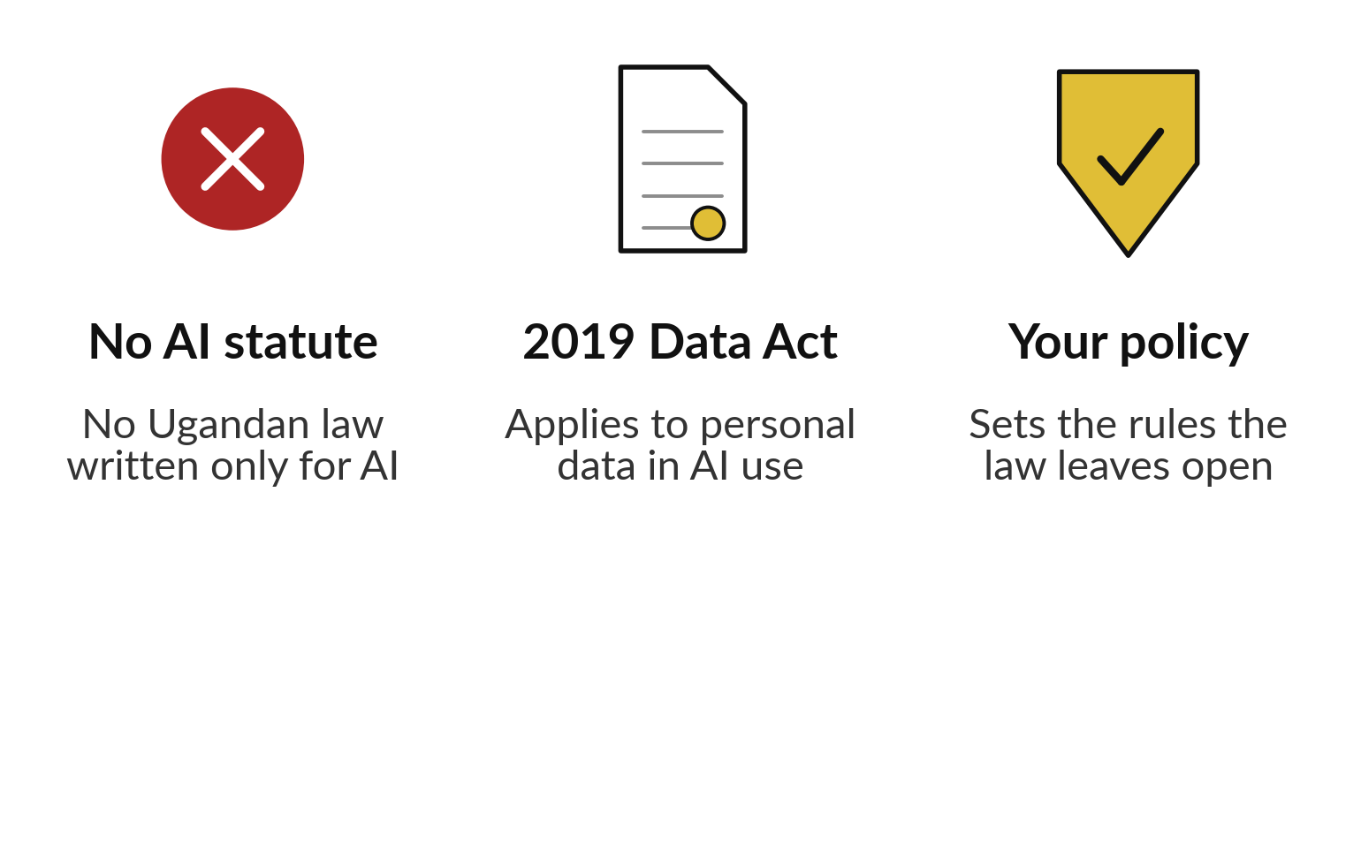
My understanding: Uganda has no AI-only
law, and the 2019 Data Act still applies
The Data Protection and Privacy Act 2019 applies when personal data goes into an AI tool.
My understanding. The source is the Act; it needs checking.
Confirm your duties with your lawyer.
Notes:
Uganda has no law written only for AI. That does not mean there are no rules. My understanding is that the Data Protection and Privacy Act 2019 applies to personal data, including when it is used with an AI tool. Your own policy then sets the rules that the law leaves open.
I am not a lawyer, and this is not legal advice. For your duties, such as registering, sending data abroad and reporting a breach, confirm with your lawyer or the Personal Data Protection Office. Anything newer, such as a national AI strategy or guidance from the Personal Data Protection Office, may have changed since this slide was written, so ask your lawyer.

Slide 10


Take five questions about
personal data to your lawyer
Which of our AI uses involve personal data?
What are our duties under the 2019 Act for each use?
Whether and when must we report a breach?
What must a vendor contract say about our data?
What must we tell staff and customers?
Notes:
Five questions to take to your lawyer or to the Personal Data Protection Office. I do not answer them for you, because the detail depends on your company and the law can change. Which of our AI uses involve personal data?
What are our duties under the 2019 Act for each use?
Whether and when must we report a breach?
What must a vendor contract say about our data?
And what must we tell staff and customers?
Until you have the answers, keep personal data such as CVs and customer lists out of free tools. Write the questions at the end of your policy draft.

Slide 11


In my experience a ban pushes AI
use out of sight, so write a policy
Ban only
Policy and approved tools
Staff may still use personal accounts.
You cannot see what data leaves.
Nobody is trained or checked.
Company accounts with a named owner.
Data rules by sensitivity.
Training and one place to report.
Shadow AI is staff using AI through personal accounts. A policy gives them a safe route.
Notes:
Many executives ask whether to ban AI. In my experience a ban often pushes use out of sight. People use personal accounts anyway, which is called shadow AI. Then you cannot see what data leaves, and nobody is trained. A policy gives staff a safe route: company accounts with a named owner, clear rules on what data may go in, training, and one place to report a problem.
Nile Valley Foods already has a handbook rule on this. We look at it now, and you will see why a single clause is a good start and not yet a policy.

Slide 12
One handbook clause is a start,
and a policy finishes the job
Nile Valley Foods staff handbook, version 4, clause 4.4. The company and the handbook are fictional.
The clause
“Staff must not paste customer personal data, price lists or contracts into a public AI tool or website unless the Managing Director has approved that tool in writing.”
What it settles
Three kinds of data stay out of public tools, and one person approves a tool in writing.
What it leaves open
Which tools are approved, what staff may paste, who checks the result, what is kept on record, and what to do after a mistake.
Notes:
This is clause 4.4 of the Nile Valley Foods staff handbook, word for word. It is a good clause. It keeps customer personal data, price lists and contracts out of public tools, and it gives one person the power to approve a tool in writing. But look at what it leaves open.
Which tools are approved right now?
What may staff paste into them?
Who checks the result before it goes out?
What do we keep on record?
And what happens after a mistake?
A policy answers those five questions. We go through them one at a time.

Slide 13



Clause 4.4 becomes a data table:
three classes and a personal-data flag
Data class | Nile Valley Foods example | May it go into an AI tool?
Public | A product list already on a flyer | Yes, in an approved tool.
Internal | The weekly sales summary | Company accounts only.
Confidential | Supplier agreements, price lists and contracts (clause 4.4) | Written approval from the Managing Director.
Personal flag | Customer names with phone numbers (clauses 4.3 and 4.4) | No, unless the tool is approved for personal data.
Notes:
Here is the data table that clause 4.4 grows into, using the classes you met in Session 4. Public information, such as a product list already on a flyer, may go into an approved tool. Internal information, such as the weekly sales summary, goes only into company accounts.
Confidential information, such as supplier agreements and price lists, needs the written approval that clause 4.4 already asks for. Personal data is a flag on top of any class. Customer names with phone numbers stay out unless the tool is approved for personal data. When staff are unsure, they treat the data as one level more sensitive.

Slide 14
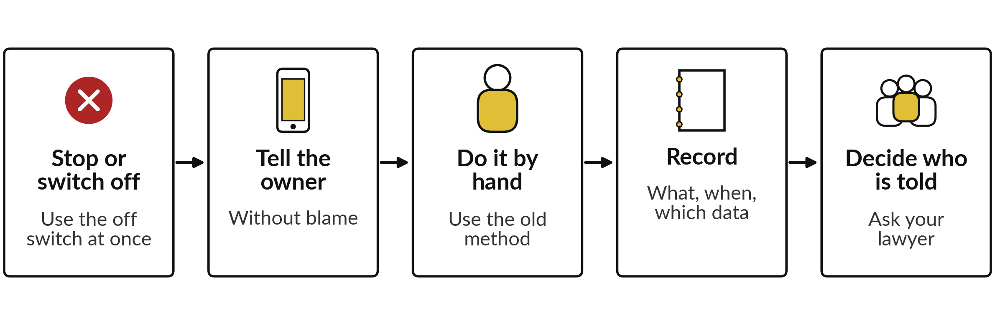
When something goes wrong:
five steps and a named person
Handbook 5.3: report a suspected data loss to the Operations Manager within 4 hours. Handbook 5.5: nobody is punished for reporting in good faith.
Notes:
Section eight of the policy covers incidents, and the handbook already holds most of it. Clause 5.3 says a suspected loss of data goes to the Operations Manager within four hours. Clause 5.5 says nobody is punished for reporting in good faith, which is what makes people report.
The five steps are these. Stop or switch off. Tell the owner. Do the task by hand. Record what happened, when and which data. Then decide who must be told, and ask your lawyer about the Personal Data Protection Office.

Slide 15




A first draft needs one plain
line for each of five parts
Policy part | Draft wording for Nile Valley Foods | Owner
Approved tools | One assistant on a company account, approved in writing by the Managing Director. | Operations Manager
Human review | Anything about money, a customer or the board is checked by a named person. | Task owner
Record keeping | Keep the prompt, the result and the checker’s name for anything sent out. | Task owner
Incidents | Report within 4 hours (clause 5.3). Nobody is blamed (clause 5.5). | Operations Manager
Policy owner | Reviewed every 6 months. Signed by the Managing Director. | Managing Director
Notes:
Now the rest of the policy in one line each. This is draft wording for Nile Valley Foods, written by me as an example, so treat it as a model and write your own. Approved tools, with one owner who keeps the list. Human review, so that anything about money, a customer or the board is checked by a named person.
Record keeping, so that you can show who checked what. Incidents, using the four hours already in the handbook. And a policy owner, with a review date. Notice that each line names a person. A rule without a name is a hope.

Slide 16
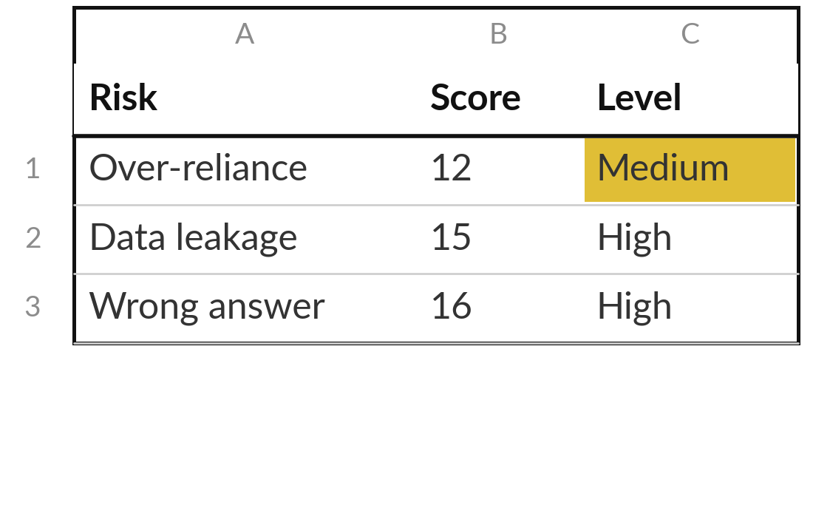
Practice: score the risks of your own task
15 minutes
Your own company task
Edit the Risk Register for your own task.
Open the Risk Register. Edit the four typical rows that matter most for your task.
Add a row for over-reliance.
Score likelihood and impact from 1 to 5.
Name one owner and one real control for each. Finish the rest after class.
You keep: A register with five scored risks, each with an owner and a control.
Notes:
Take fifteen minutes. Open the Risk Register. The eight grey rows are typical risks. Pick the four that matter most for your own task and edit them. Add a row for over-reliance. You will not finish all rows in fifteen minutes, and that is fine: finish the rest after class.
Score likelihood and impact from the Scale sheet, and read the level it gives. Then name one owner and one real control for every row. If you are stuck, ask who would be hurt first if the AI made a mistake tomorrow, and score that risk first. I will check your High rows with you.

Slide 17
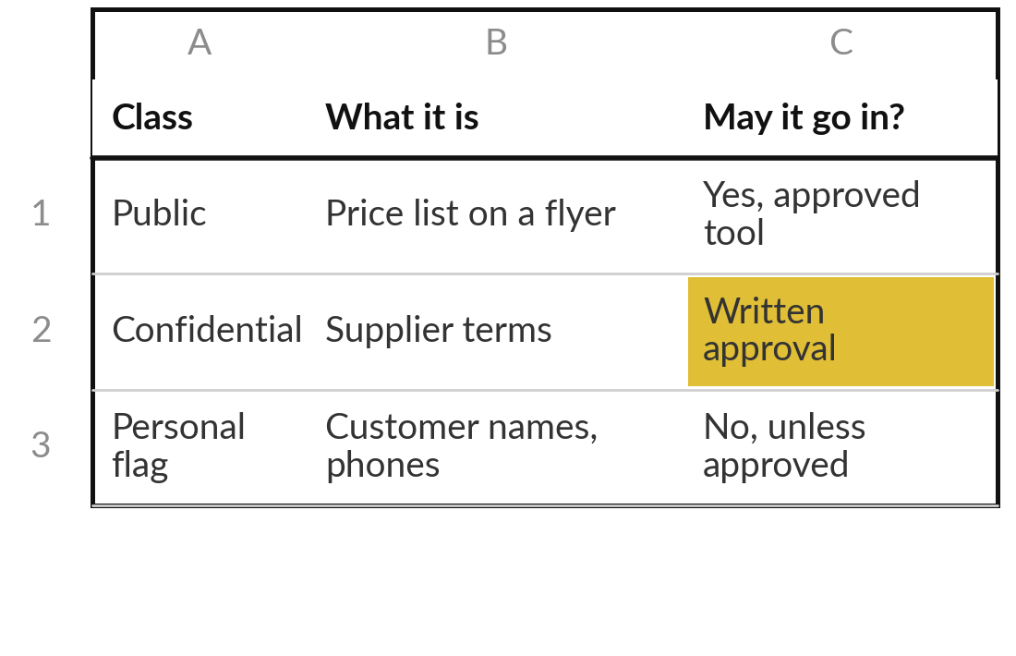
Practice: write the tools and the data rules
15 minutes
Your own company task
Fill sections 3 and 4 of the AI Use Policy Template.
Open the template. Replace each square bracket in section 3 with your own words.
List each approved tool with an owner and a company account.
Fill the data table using the classes from your Session 4 inventory.
Mark the rows your lawyer must check.
You keep: Sections 3 and 4 of your policy: approved tools and the data table.
Notes:
Fifteen minutes. Open the AI Use Policy Template and go to section three. List the approved tools, each with a named owner and a company account, never a personal one. If your company has not approved any tool yet, write the one you would approve first and who must say yes.
Then go to section four. Use your Information Inventory from Session 4 and fill the data table class by class. When you are unsure, write the more careful answer. Mark any row that your lawyer must check, especially personal data.

Slide 18
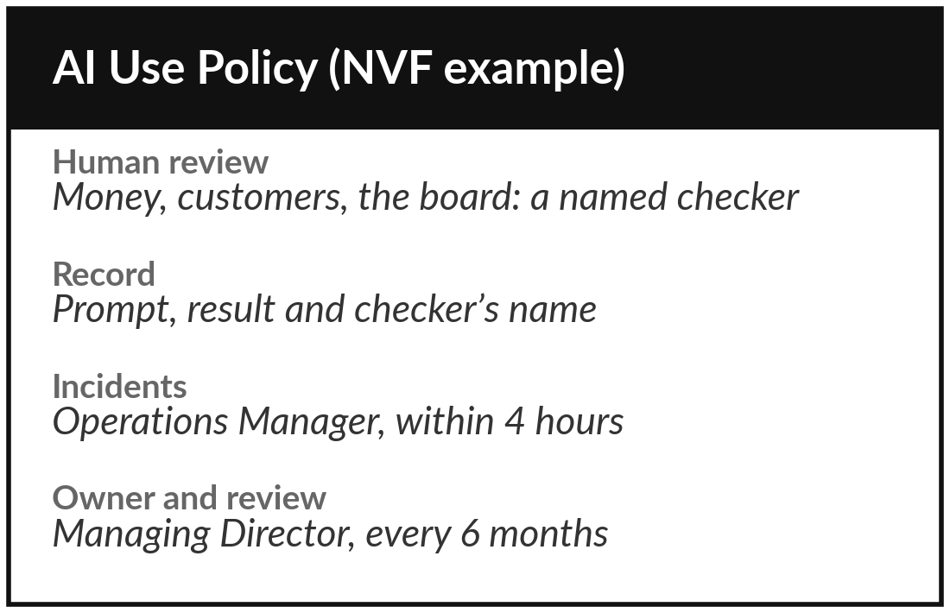
Practice: write review,
records, incidents and owner
15 minutes
Your own company task
Fill sections 5, 7, 8 and 10 of the template.
Section 5: list what always needs a named reviewer.
Add one line on what you keep on record.
Sections 7 and 8: name the owner, who hears about an incident, and how fast.
Section 10: a review date. Read sections 1, 2, 6, 9, 11 after class.
You keep: The rest of your policy draft, ready to share with colleagues and your lawyer.
Notes:
The last fifteen minutes of your own work. Section five, human review. List what always needs a named reviewer, such as anything about money, hiring, contracts or customers. Add one line on what you keep on record, so that you can show who checked what. Sections seven and eight, ownership and incidents.
Name the owner, who hears about an incident and how fast. Section ten, a review date, six months is a common start. Records go in section five. Sections one, two, six, nine and eleven keep the default wording for now: read them and change them after class. If you run short of time, finish the incident step, because that is the one you need on the worst day.

Slide 19



Decision: who owns your AI use policy?
Who will own your policy and keep it up to date?
The Managing Director
The manager closest to the tools
An owner and a deputy
Accountable for the company. Signs the policy and reviews it twice a year.
Knows the tools and the incidents. Needs the owner to sign.
Two named people, so the policy does not stall when one is away.
Write the owner, the deputy and the review date on the policy.
Notes:
One decision to finish. Who owns your policy?
The Managing Director, because the policy is about what the company is accountable for. Or the manager closest to the tools, who knows the incidents, though the owner still has to sign. Or an owner and a deputy, so the policy does not stall when one person is away.
In a small company I would choose an owner and a deputy. Say your choice and your reason aloud, then write the owner, the deputy and the review date on the policy.

Slide 20
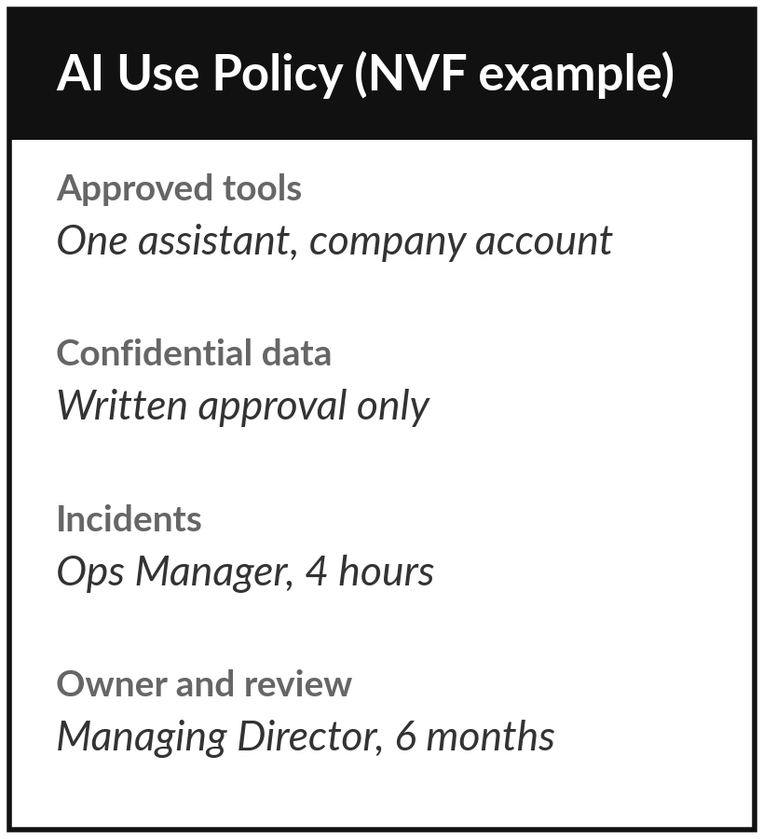
Save the draft, and share it
with the people it affects
What you keep from today
Your Risk Register for the own task and the first draft of your company AI use policy, written from the template.
Our question today
What may my staff do with AI, and what rules should my company set?
Next session
Session 10: Buying and oversight. Optional: bring an AI product proposal or pitch you have received.
Notes:
Save the register and the policy draft together, in the same folder as your Information Inventory from Session 4. Share the draft with the people it affects, and ask your lawyer to read it before the owner signs. Optional, if you want a head start on Session 10: bring any proposal or pitch for an AI product that your company has received, or name a tool you already pay for. We take a vendor proposal apart next time.
We began with this question: What may my staff do with AI, and what rules should my company set? Before you go, say in one sentence what you can now say about it.

